Slide 1

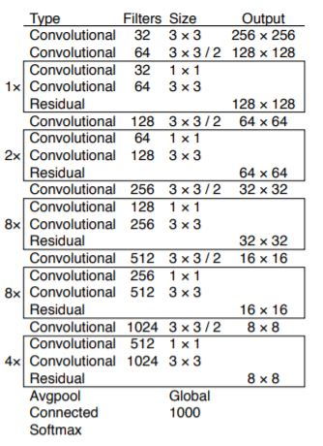
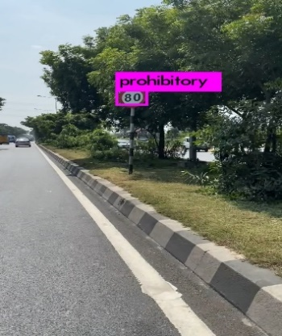
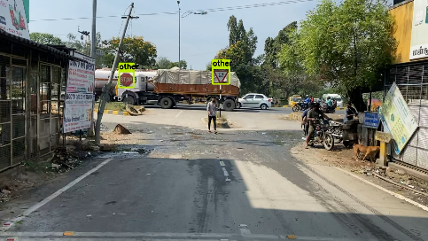
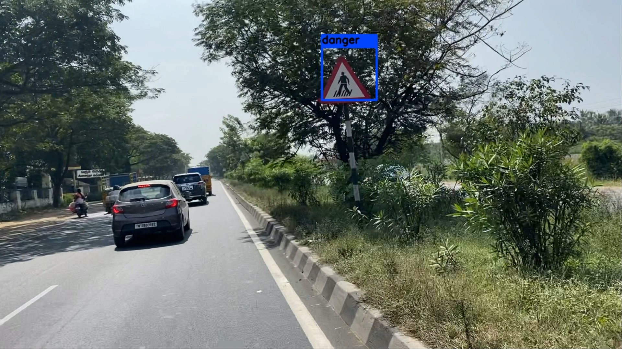
SIGN BOARD RECOGNITION USING CONVOLUTIONAL NEURAL NETWORK
G.MANIDEEP,D.MOUNESH RAJU,G.PENCHALA SAI TEJA,V.SRAVAN CHOWDARY (RA1611004010101)(RA1611004010361)(RA1611004010536)(RA1611004010541)
Project Supervisor : Dr.C.T.Manimegalai,Associate Professor
Department of Electronics & Communication Engineering, SRMIST, Kattankulathur,Chennai,603203
ABSTRACT
METHODOLOGY
YOLOv3 ARCHITECTURE
RESULTS
Road injuries are a big drawback in society for a few time currently. Ignoring sign boards while moving on roads has significantly become a major cause for road accidents. Thus we came up with an approach to face this issue by detecting the sign board and recognition of sign board. At this moment there are several deep learning models for object detection using totally different algorithms like RCNN, faster RCNN, SPP-net, etc. We prefer to use Yolo-3, which improves the speed and precision of object detection. The greatest advantage of this algorithm is that the whole picture is taken into account. It just uses a convolution neural network to derive features from pre-weights and contrast. This algorithm will increase the accuracy by utilizing residual units, skip connections and up-sampling. This algorithm uses a framework named Dark-net. This framework is intended specifically to create the neural network for training the Yolo algorithm.To thoroughly detect the sign board, we used this algorithm.
FLOW CHART
First step involves extraction of character boundaries i.e, contours can be explained simply as a curve joining all the continuous points. The contours are a useful tool for shape analysis and object detection and recognition.Character recognition with the use of OpenCV contours method.
Next step is buildind convolutional neural network of 106 convolution layers with 53 layers each in YOLO v3 detector and classifier.
Third step involves the loading of pre-trained Imagenet dataset to the CNN classifier.
Optical Character recognition last step involves preprocessing of image into speciﬁc word related contours and letter contours, followed by prediction and consolidating according to letter and word related contours in an image.
ALGORITHM
Basically Yolo divides the image into regions, then predicts the boundary boxes and probability classes for every such region. Generally, yolo divides the visual image into an array of n rows and n columns of grid units, each grid divides into k boundary boxes and the trust value. Trust score implies that the accuracy of the boundary box actually holds the object. Scores for each box will be estimated by yolo for each training session. Finally we can combine the both classes to calculate the probability of each class in the boundary boxes.
So, total n*n*k boxes are predicted. However, the boxes which have confidence score less than a threshold, we can remove them.Yolo2 and Yolo3 are advanced versions of base yolo network with several enhancements to increase the detection speed and accuracy. The primary benefit of using Yolo-3 over its previous ones is its ability to detect both smaller objects and distinct objects in a single picture. Then by using regression scores for each classes are determined.
YOLO-3 uses a variant of Dark-net, which consists of 53 layer network trained on Image-Net. Yolo3 network considers the image as an n*n grid of sub-images and predicts the class probabilities and boundary boxes for sub-image.The boundary boxes constitutes of four parameters. Such parameters are location of the center of the object along the X axis, the location of the center of the object along the Y axis, the breadth of the object and the length of the object.
Yolo-3 can be used effectively for the identification of objects on real time basis. Since modern days applications need everything rapidly, we can utilize Yolo-3.
Sometimes due to obscure images, the detector might not predict the sign board accurately. So based on the features like shape, texture we divided the 43 classes further into four categories. We are able to detect 43 classes divided into 4 categories (prohibitory, mandatory, danger, other) which are defined in the GTSDB Dataset. Out of the 43 classes 12 classes are assorted to prohibitory, 8 classes assorted to mandatory, 15 classes assorted for danger and remaining classes to other which can be seen in below table.We are able to detect the sign-boards in an image at 9 FPS.Figure A and Figure B and C are detected sign boards for some samples.
EXTRACT CHARACTERS
BUILD CONVOLUTIONAL NETWORK
Class | GTSDB Dataset Sign Boards
Prohibitory | Speed Limit(20,30,50,60,70,80,100,120), No Overtaking, No Overtaking (trucks), No traffic both ways, No trucks
Mandatory | Go Right, Go Left, Keep Left, Keep Right, Go Straight, Go Left or Straight, Go Right or Straight, Roundabout
Danger | Bend left, Bend right, Bend, Uneven road, Slippery road, Road narrows, Construction, Traffic Signal, Pedestrian Crossing, School Crossing, Cycles Crossing, Snow, Animals, Priority at next intersection, Danger
Other | Priority road, Give Way, Stop, Restriction Ends for 80kmph, Restriction Ends, No Entry, Restriction ends (overtaking), Restriction ends (overtaking (trucks))
LOAD TRAINED CONV NET MODEL
SYSTEM MODEL
CONSOLIDATE PREDICTIONS
This algorithm uses darknet framework for building the structure required for Yolo. It consists of 53 layers each for pre-trained dataset and the dataset we used.There are 2 Conv layers with 32 filters of sizes 3*3 and 1*1, 3 Conv layers with 64 filters of sizes 3*3/2 and 1*1, 3 Conv layers with 128 filters of sizes 3*3/2 and 1*1, 3 Conv layers with 256 filters of sizes 3*3/2 and 1*1, 3 Conv layers with 512 filters of sizes 3*3/2 and 1*1, 3 Conv layers with 1024 filters of sizes 3*3/2 and 1*1.Some of the convolutional layers are followed by a residual block to accommodate skip connections. There are at total 23 residual units. So, there are at total 106 layers in Yolo-3.Of these 106 layers, 75 layers are utilized for the purpose of convolution and the remaining 21 layers are used by activation function, up-sampling, pooling etc.
Yolo-Detector
CNN Classifier
A) Detected sign board for sample with Speed Limit 80 Kmph sign.
Bounding Box Pre-Processor
Pre-Processed Bounding Box
Re-Lu Layer
Convolution Layer
Pooling Layer
Input Image
Output Image
MULTIDISCIPLINARY ASPECTS
C) Detected sign board for sample with Pedestrian Crossing Sign
Machine Learning:We need to have a sheer knowledge of machine learning models(Deep Learning) for object detection.
Image Processing:We should have an absolute idea about image processing and the parameters involved in it.
Programming Language:Today most of the machine learning models are implemented using Python.So one should have thorough knowledge in it.
B) Detected sign board for sample with Give Way and Stop signs
CONCLUSION
The above figure illustrates the object detection by Yolo v3 algorithm.Once the input image is sent to the Yolo detector,it processes the image and then it predicts the boundary boxes for each and every object in the image.It generates five parameters for an object in the image i.e, center of object along X-axis,center of the object along Y-axis,length of the object and breadth of the object,confidence score.Confidence score is defined as the probability of the presence of object in particular bounding box.Once the bounding boxes are processed,they are sent through the CNN classifier.With the help of pretrained dataset “ImageNet” ,the features are extracted.Comparing the features of Bounding box objects with that of pretrained dataset,the CNN classifier distinguishes the objects.This design uses the third variant of Yolo.We have a total of 53 convolutionl layers in Yolo phase and 53 convolutionl layers in classification phase.So at total this model has 106 convolutional layers.Our main motivation for using Yolo-3 for object detection is that it has higher frame rates as compared to other algorithms. The farther traffic sign boards can be recognized from the vehicle by simply moving the image only once through the neural network.In this paper, we worked extensively with Yolo-3 to detect sign boards for both image and video formats.
The project is intended to preserve valuable lives by preventing deaths incurred by traffic signals being ignored. The system mostly focuses on the bulk of the population, particularly those who used to be driving at night, and also helps the traffic police to alleviate problems. This initiative's main concept is the traffic accidents sustained by the neglect of road signals by the driver.
REALISTIC CONSTRAINTS
Requirement of huge amount of data for training YOLOv3 CNN model.
The Processor speed defines the frame rate i.e,number of frames per second .So it should be fast in order to get good accuracy.
Resolution of the camera should be good to detect the objects or sign boards.
Some times due to bad weather conditions,detection may be arduous.
REFERENCES
ENGINEERING STANDARDS
de Oliveira, G. H., da Silva, F. A., Pereira, D. R., de Almeida, L. L., Artero, A. O., Bonora,A. F., and de Albuquerque, V. H. C. (2018). “Automatic detection and recognition of text- based traffic signs from images.” IEEE Latin America Transactions, 16(12), 2947–2953.
Fang, C.-Y., Chen, S.-W., and Fuh, C.-S. (2003). “Road-sign detection and tracking.” IEEE transactions on vehicular technology, 52(5), 1329–1341.
Greenhalgh,J.and Mirmehdi,M. (2014).“Recognizing text-based traffic signs.”, 16(3), 1360–1369. IEEE Transactions on Intelligent Transportation Systems
Wu, W., Chen, X., and Yang, J. (2005). “Detection of text on road signs from video.” IEEE Transactions on Intelligent Transportation Systems, 6(4), 378–390.
Xie, L., Ahmad, T., Jin, L., Liu, Y., and Zhang, S. (2018). “A new cnn-based method for multi-directional car license plate detection.” IEEE Transactions on Intelligent Transportation Systems, 19(2), 507–517.
IEEE Standards for Intelligent Transportation Systems: The transportation sector is undergoing a massive transformation through electrification and automation. Autonomous vehicles will open up new opportunities for Mobility-as-a-Service (MaaS). As part of the global technology ecosystem, the IEEE Vehicular Technology Society Intelligent Transportation Systems (VTS/ITS) collaborates and coordinates with many other organizations, in particular the Computer Society, the Communication Society and the Instrumentation and Measurement Society. IEEE groups also consider artificial intelligence issues for autonomous vehicles. AI topics also correlate with the IEEE P7000 series of standards projects addressing ethical considerations for AI and autonomous systems.

